Slide 1
BULLYING
Evelyn Dayana Castaño
Valeria Maldonado Niño
Luisa fernanda Mina
Maria Alejandra Giraldo

Slide 2
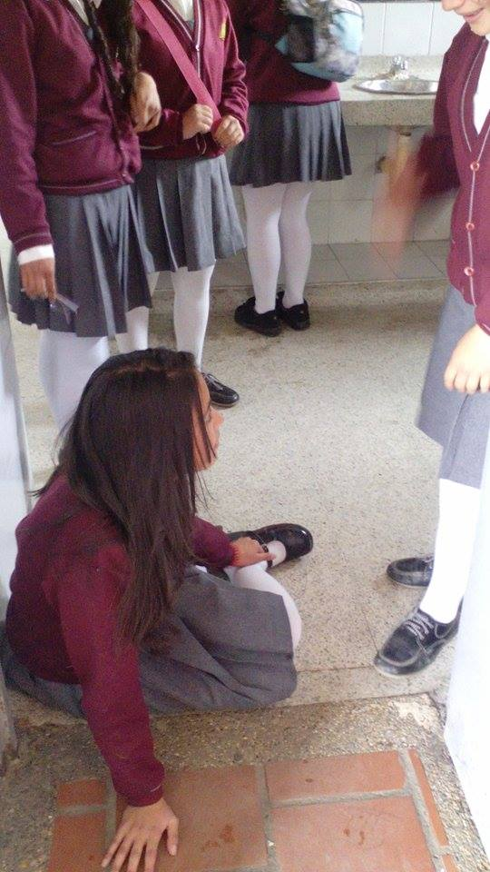
What Is Bullying?
Bullying Is a form of exclution social .

Slide 3
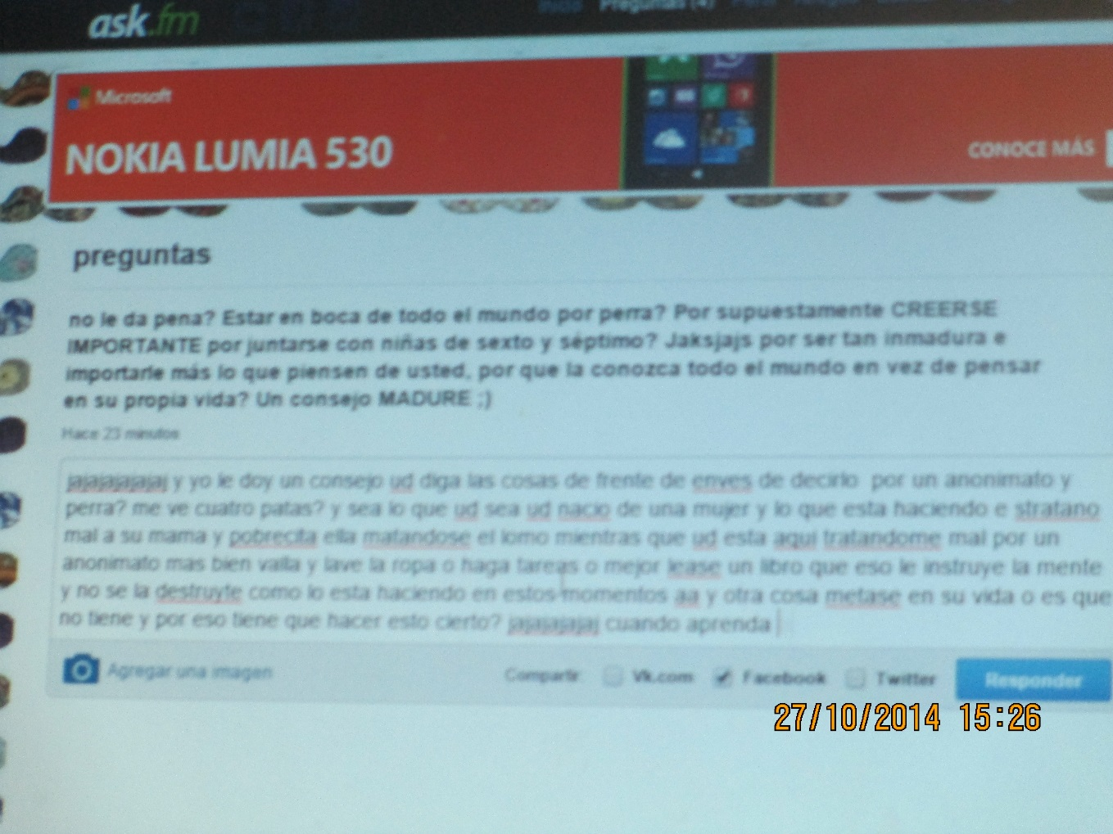
Types of bullying
Cyberbullying
Sphycological
Verbal
Physical

Slide 4
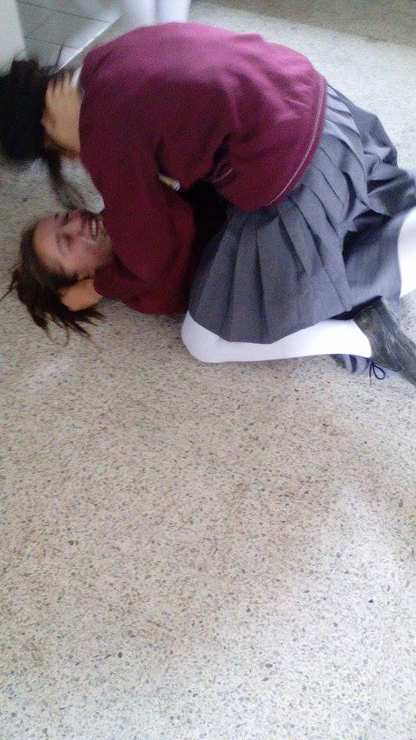
victims
The victims ever are people with physocogics problems of different country etc

Slide 5
conclusions
bullying is bad because it affects lives
Bullying should not do because we feel bad to others and so we do not want to feel
no to bullying, as victims can always do bad things to bad decisions to suicide
Bullying hurts more lives shows the devil side of us and brings out our secrets to only be odd or misunderstood

Slide 6
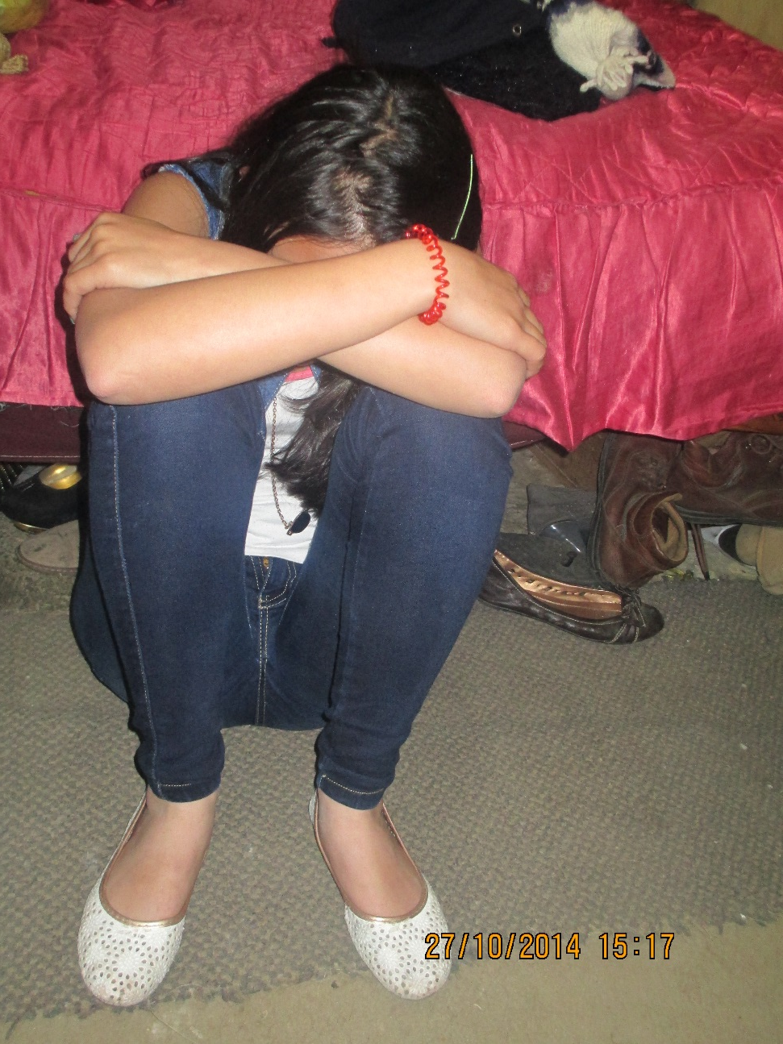
bibliography
Wikipedia
Google traductor

