Slide 1
SCHOOL DISTRICT ENRIQUE OLAYA HERRERA
*Luisa Fernanda Clavijo*
*Karen Contreras *
*Juan Caycedo*
Grade: 901

Slide 2
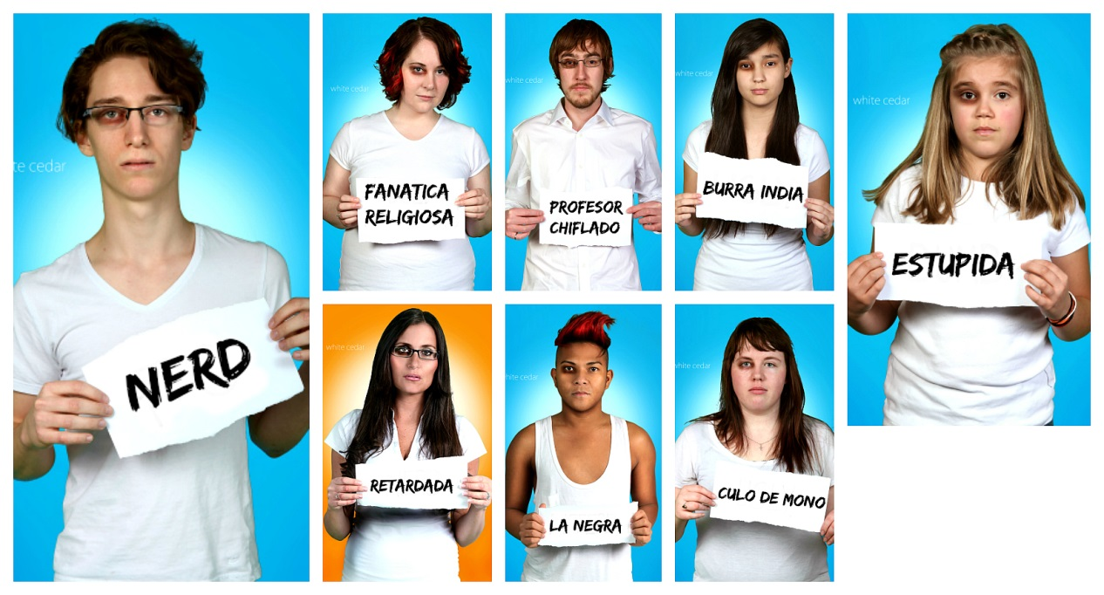
BULLYING.

Slide 3
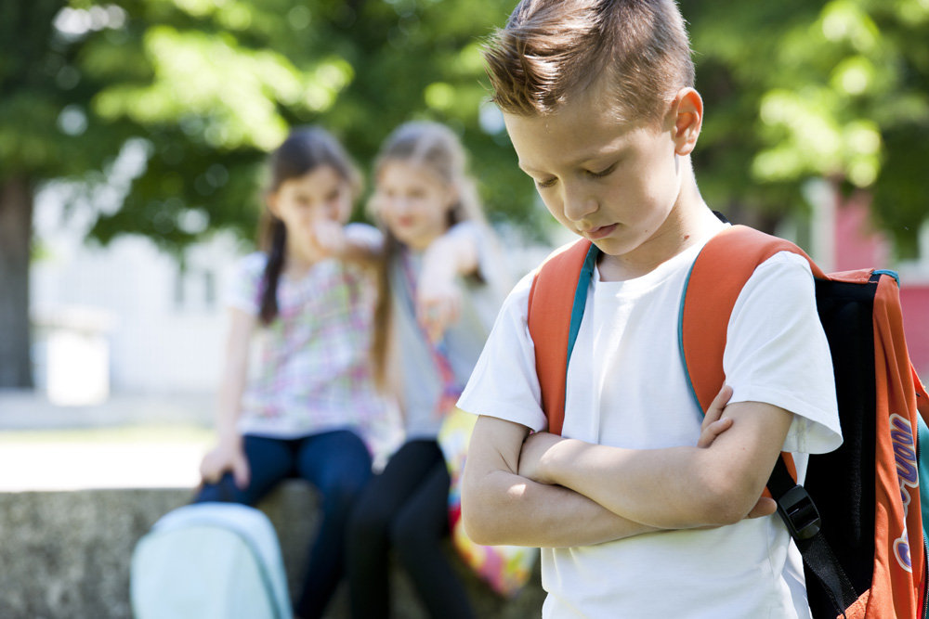
¿WHAT IS THE BULLYING?
Bullying is psychological or physical abuse towards another person, making a kind of intimidation in order to submit or scare, is continuously repeated taunts, assaults causing the victim adopts a state of depression and sadness almost always.

Slide 4
TYPES OF BULLYING.
Types of bullying:
Physical: assaulting the victim with hitting, shoving, fists, etc.
Verbal: They intimidate the victim through words, humiliation, etc.
Psychological: with each act of the perpetrator creates a degree of bullying on the victim which ultimately affects their psychological condition, end up isolating themselves from the world.
Cyberbullying: through internet, social networking messages.

Slide 5
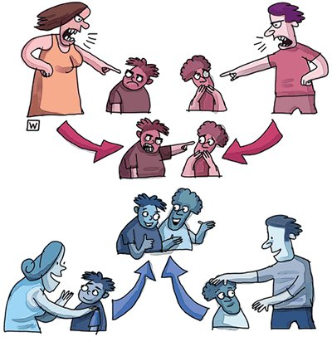
HOW TO HANDLE THE SITUATION.
Inform Always your parents and authorities.
Confidence in yourself.
See 'Do not let your fear of bullies

Slide 6
CONCLUSION.
Bullying can cause a person to completely isolate yourself from society, suffer psychological and physical disorders and can reach up hurting himself, so they must put strong rules and standards to prevent bullying and we know the consequences of this, to never commit.

