Slide 1
Bullyng in the school and in neighborhood
José Ignacio lozano chilatra
Alejandro Gutiérrez cárdenas
Andrés Felipe lopes Ávila
Valery lozano García

Slide 2
Bullyng in the school

Slide 3
bullying reasons
Children who are teased because they are mannered. Others who are rejected for being too smart. Others because they are not the most skilled on the court. Girls whose honor is degraded in internet for not accepting certain boy. Being fat or skinny, shy or very popular, pretty or ugly can be used against any other or others peers in what psychologists call bullying or bullying.

Slide 4
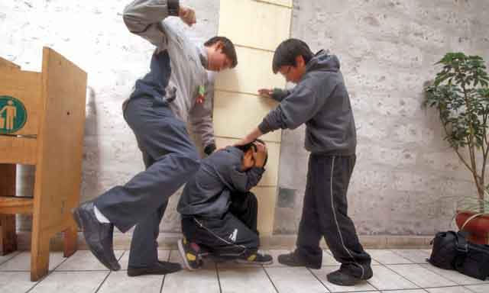
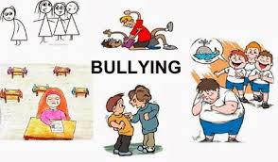
main types of bullying
physical abuse
psychological maltreatment

Slide 5
bullying cases in school
1 Girl, 12, victim of school bullying, suffered a ruptured septum
2 Homosexual students in Japan are bullied at school
3 over death of child in case of bullying
4,5,6,7………1000 and many more

Slide 6
no more school bullying
School bullying is unacceptable no more this kind of abuse comes in many forms affects us all.
¿¿ What are willing to do that this change ??

